Slide 1
Best practices for evaluating business continuity software

Slide 2
Real-world operations are anything but static
How can you build and informed software decision making process?
BCI Continuity and Resilience Report 2023

Slide 3
67.8%
79.7%
80%
report that a board member is responsible for their resilience program
of respondents to BCI survey say they have plans to change their current BIA process
report a heightened recognition of the importance of having a BC Program
BCI Continuity and Resilience Report 2023

Slide 4
The world is changing, and more complex than ever before
Distributed workforce and complex supply chains
Geo-political
Cyber related incidents
Increasing occurrence and severity of natural disasters
Marco-economic pressures
Risk and resilience practitioners must look to drive more value, operate more efficiently, and operate from a position of command and control.
BCI Continuity and Resilience Report 2023

Slide 5
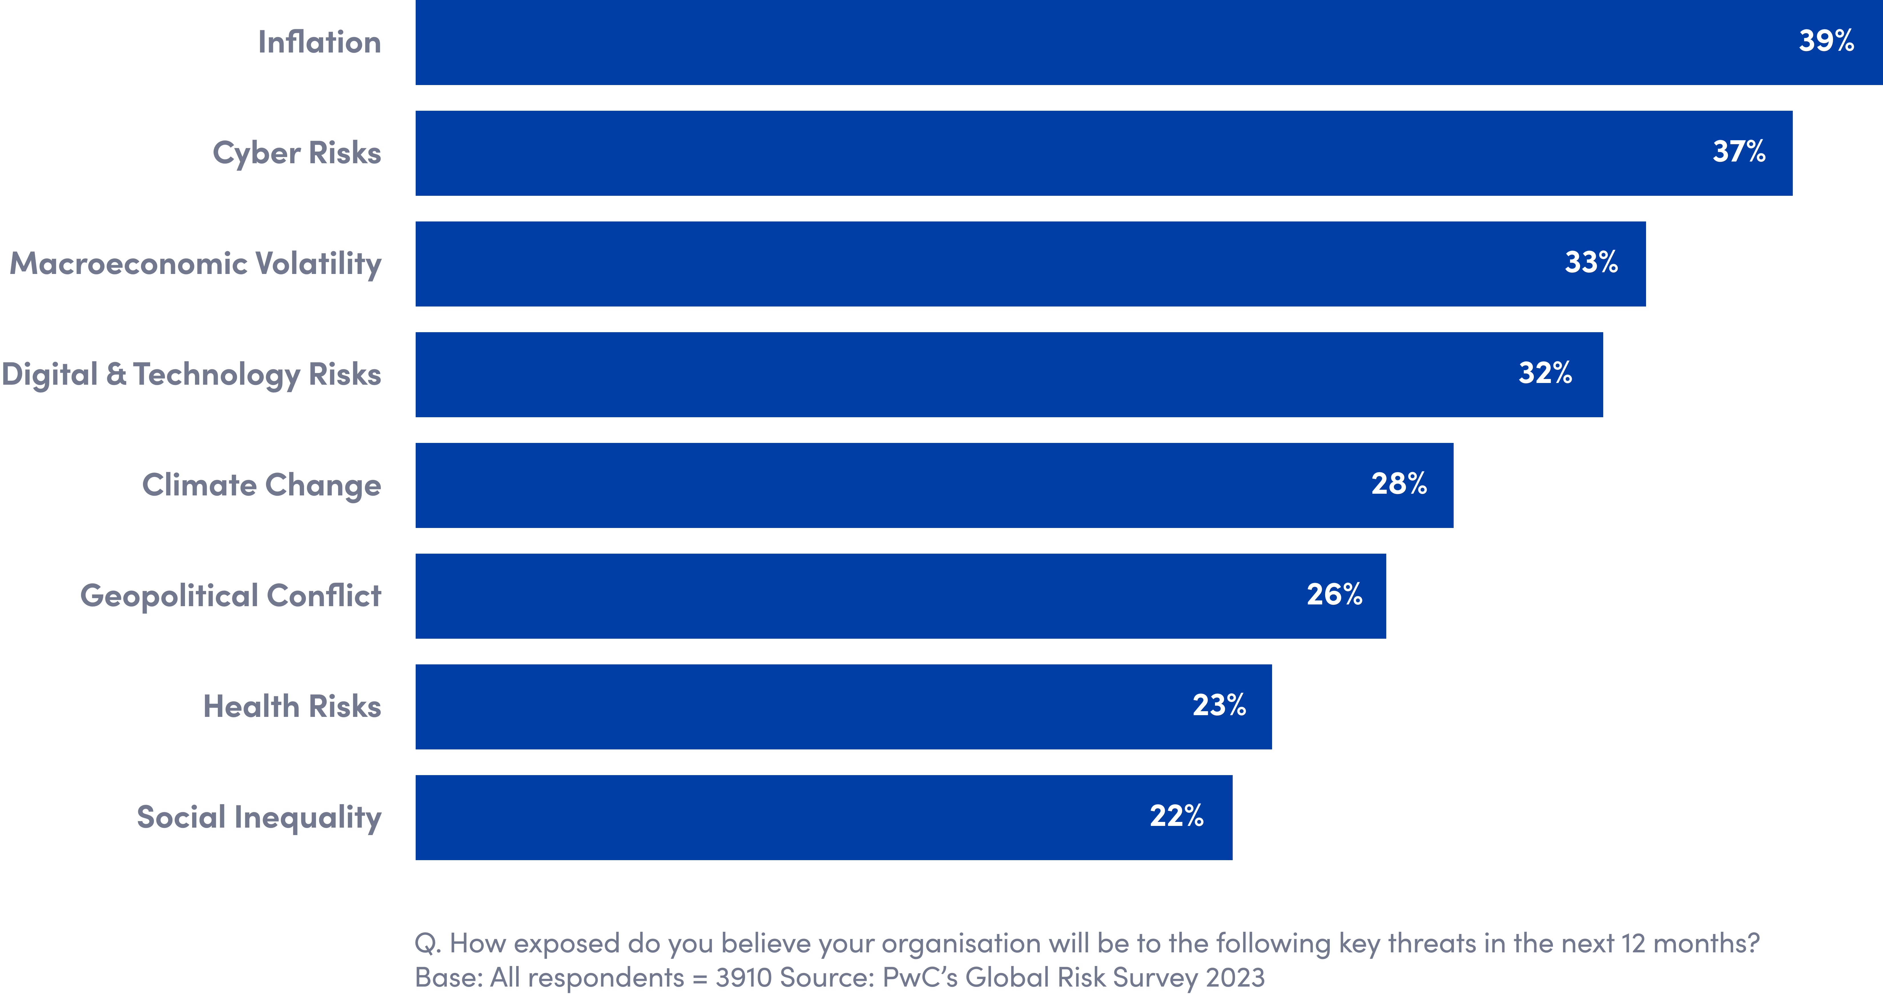
Top threats organizations say they feel highly or extremely exposed to in the next 12 months
BCI Continuity and Resilience Report 2023

Slide 6
Before evaluating software, it’s important to codify and understand “Why Software.”
Force Multiplier
Data Integrity
Data Aggregation + Analysis
Competitive Advantage
Software will enable our limited team to accomplish more, with less.
Significant data quality and integrity concerns with manual tools. Software will pull from golden source data and give us confidence in the insights we share with leadership and decisions with inform.
In order to justify an investment in resilience, and gain executive support – it’s imperative to be able to surface key risk/resilience insights to better inform decision making, resource allocation, etc.
Organizations that invest in resilience software have better visibility and can operate from a position of command + control.
BCI Continuity and Resilience Report 2023

Slide 7
After the value and need for software is understood, it’s critical to de-risk the decision-making process and ensure an informed decision.
The right decision will enable your success and enhance your career.
The wrong decision could have detrimental impact both personally and professionally.
The following dimensions should be evaluated, and stress tested:
Technology vendor health and viability
Strength of community
Powerful Analytics + Insights – Risk Data as Currency
Proven track record for product innovation and investment(over the last 24+ months)
Deep Technical/Functional Analysis
BCI Continuity and Resilience Report 2023

Slide 8
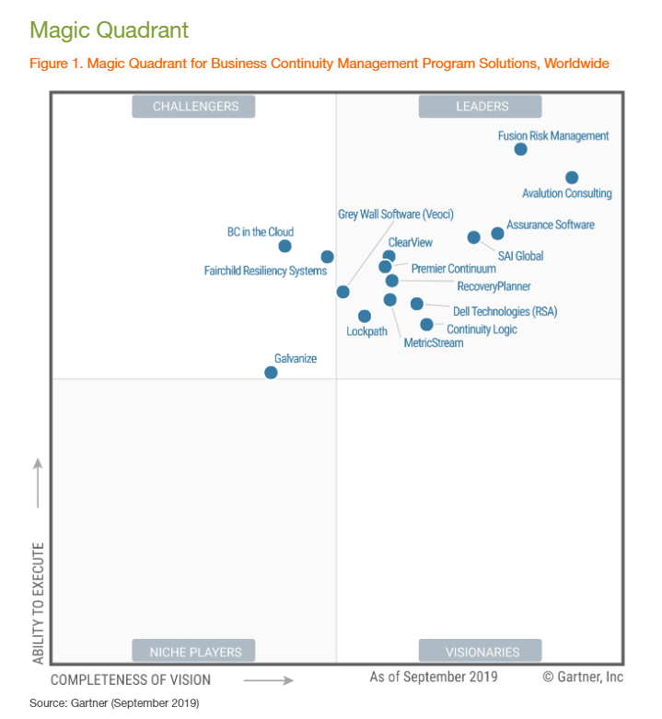
Determine company health and viability
Financial/Cash Position in the short and long term
Market leadership/presence
Total percentage of revenue/business in continuity and resilience solutions
BCI Continuity and Resilience Report 2023

Slide 9
Community
Will I be operating on an island or alongside a group of industry leaders?
Seek more information and to engage with in-person events, and community series
Any organization can tee up 1 or 2 “references” – do you think they’d engage a dissatisfied client?
BCI Continuity and Resilience Report 2023

Slide 10
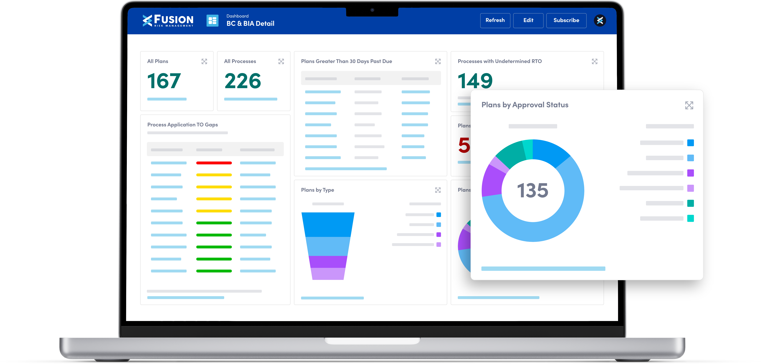
Powerful Analytics + Insights – Risk Data as Currency
Risk Data is currency - Those that harness the power of software, and key resilience data – will have a seat at the table.
I’ve found many organizations don’t prioritize and validate the power of the analytics engine.
If we can’t effectively aggregate, visualize, and share key risk and resilience insights with ease – what’s the point..?
Do your executives actively seek out plan documents?
BCI Continuity and Resilience Report 2023

Slide 11
Deep Technical Analysis
It’s critical to stress test all potential partners, as you evaluation software. If your technical requirements lack the necessary depth/detail – you will struggle to separate partners E.g.:
In a formal evaluation, these criteria are used to drive analysis and decision-making process – the more thorough and specific you are – the better your probability for success.
“can you integrate with X system.” every provider will say “YES”
“does your system support plan building and BIA creation” every provider, including word can say “YES”
BCI Continuity and Resilience Report 2023

Slide 12
Thank You
@fusion-risk-management
@FusionRiskManagement
@FusionRiskMgmt

